Slide 1
Lesson-3
Top-Down Design with Functions
In C-Language

Slide 2
Objectives
To learn about functions and how to use them to write programs with separate modules
To understand the capabilities of some library functions in C
To understand how control flows between function main and other functions
To learn how to pass information to functions using input arguments
To learn how to return a value from a function

Slide 3
Functions-C’s Building Blocks
Road Map!!
Introduction to structured Programming
Functions: Definitions and Creation
Types of Functions
User-Defined Functions
Standard Library Functions
Function Prototypes
Function Calls
Call by Value
Call by Reference
Variable Scope

Slide 4
Introduction to structured Programming
Structured programming: This is a programming technique of breaking large complex programs into small manageable components. This small components are called functions in C programming language.
Structured programming contains many concepts ranging from theoretical to application.
The most relevant structured programming concepts include:
Top-down design
Code reusability
Information hiding

Slide 5
Structured Programming Concepts
Top-Down Design
Common with procedural languages such as C, top-down design enables analysts and programmers to define detailed statements about a system’s specific tasks.
Case Study - 1
Suppose your non-technical boss tells you to program the software for a new ATM system for the Big Money Bank. You would probably wonder where to begin as it's a large task filled with complexities and many details.

Slide 6
Case Study -1:ATM System
In C, the top component is the main() function from which other components are called.
ATM-Major Components
Display balance
Deposit funds
Transfer funds
Withdraw funds
Withdraw funds component
Get available balance
Compare available balance to amount requested
Update customer’s account
Distribute approved funds
Reject request
Print receipt

Slide 7
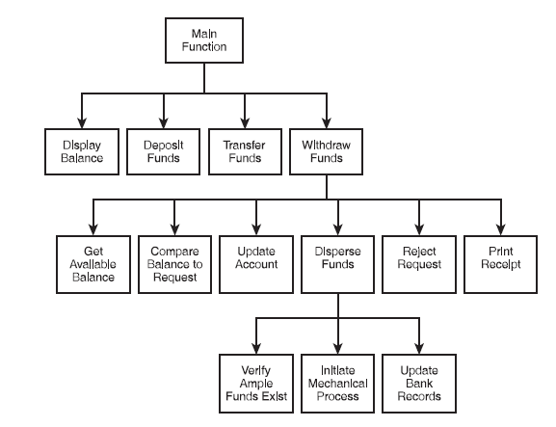
ATM-System

Slide 8
Functions: Definitions and Declaration
What is a Function?
A function is a collection of statements grouped together to do some specific task. Every C program has at least one function i.e. the main()
Why use functions?
A program is a collection of small tasks that may depend on other tasks. You can use two approaches to write a program.
Write code for all tasks in single place, in the main() function sequentially
Divide code for all tasks into separate functions. Use main() function to execute all other tasks

Slide 9
Functions: Definitions and Declaration
Advantages of dividing program into functions
Reusability of code. Functions once defined can be used any several times.
Abstraction. T o use any function you only need is name and arguments it accepts. You need not to know how it works internally.
Modular design of code. Function allows. We can divide program into small modules. Modular programming leads to better code readability, maintenance and reusability
Programs easier to write using functions. You can write code for separate task individually in separate function.
Maintenance and debugging of code is easier. In case of errors in a function, you only need to debug that particular function instead of debugging entire program.

Slide 10
Functions: Definitions and Declaration
Function declaration
Like variable declarations functions are also declared. Function declaration tells the compiler that there exists a function with some name that may be used later in the program. Function declaration is also known as function prototype or function signature.
Function declaration
return_type function_name( parameter_list );
A function declaration must be terminated using semicolon; You can declare a function anywhere in the program. However, it is best practice to declare functions below pre-processor directives.
Function definition
return_type function_name(parameter list)
{
// Function body
}

Slide 11
Functions: Definitions and Declaration
Function declaration and definition syntax must be same. You are free to put function definition anywhere in your program, below its declaration. However, it is recommended you to put all declarations below the main() function.
Run Example Code
Function calling
The most important part of function is its calling. Calling of a function in general is execution of the function. It transfers program control from driver (current) function to called function.
Syntax:
See Example Code
function_name( parameter_list );

Slide 12
Functions: Definitions and Declaration
A function declaration in C programming consists of the following parts:
Return Type − A function may return a value. The return_type is the data type of the value the function returns.
Function Name −Function name is a valid C identifier that uniquely identifies the function. You must follow identifier naming rules (similar to variables rules) while naming a function.
Parameters − A parameter is like a placeholder. When a function is invoked, you pass a value to the parameter. This value is referred to as actual parameter or argument.
Function Body − The function body contains a collection of statements that define what the function does.

Slide 13
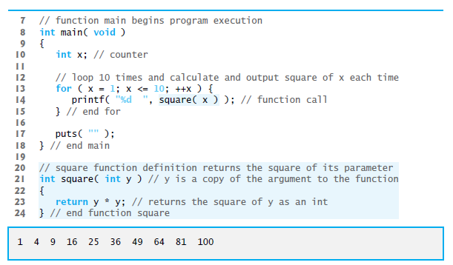
Functions: Definitions and Declaration
See Code

Slide 14
Code Reusability
In the world of application development, code reusability is implemented as functions in C.
Specifically, programmers create user-defined functions for problems that generally need frequently used solutions.
The following list is a possible number of transactions a customer might perform at a single visit to an ATM.
Deposit monies into a checking account
Transfer funds from a checking to a savings account
Withdraw monies from checking
Print balance

Slide 15
Code Reusability
Writing code structures every time you need to access someone’s balance doesn’t make sense, because you can write a function that contains the logic and structures to handle this procedure and then reuse that function when needed.
Putting all the code into one function that can be called repeatedly will save you programming time immediately and in the future if changes to the function need to be made.

Slide 16
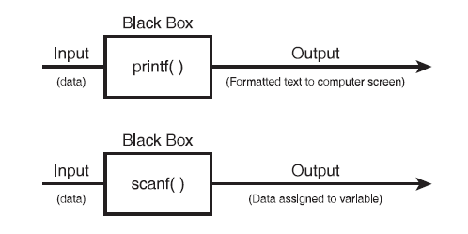
Information Hiding
Information hiding is a conceptual process by which programmers conceal implementation details into functions. Functions can be seen as black boxes. A black box is simply a component, logical or physical, that performs a task.

Slide 17
Types of Functions
Depending on whether a function is defined by the user or already included in C compilers, there are two types of functions in C programming:
Types of Functions:
User defined functions
Standard library functions
User defined functions:
These are self-contained blocks of statements which are written by the user to compute or perform a task.

Slide 18
User-Defined Functions
void functionName()
How user-defined function works?
#include <stdio.h>
void functionName()
{
... .. ...
... .. ...
}
int main()
{
... .. ...
... .. ...
functionName();
... .. ... ... .. ...
}
The execution of a C program begins from the
main() function.
When the compiler encounters
functionName(); inside the main function, control of the program jumps to
void functionName()
And, the compiler starts executing the codes inside the user-defined function.
The control of the program jumps to statement next to
functionName();
once all the codes inside the function definition are executed

Slide 19
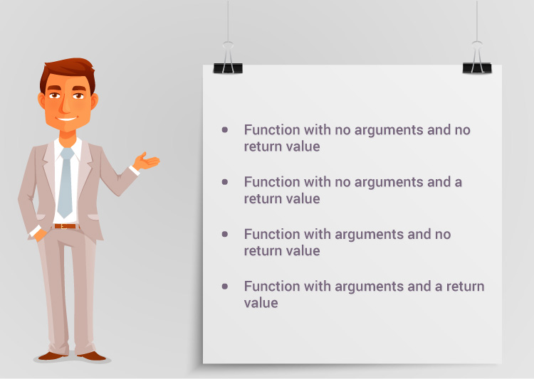
Types of User-Defined Functions
For better understanding of arguments and return value from the function, user-defined functions can be categorized as:

Slide 20
checkPrimeNumber()
checkPrimeNumber()
Functions with no Argument and no return Value
checkPrimeNumber()
checkPrimeNumber()
checkPrimeNumber()
Syntax
functname();
Example:
checkPrimeNumber();
Interpretation
the function functname is called
after functname has finished execution, the program statement that follows the function call will be executed
Example: The program checks whether an integer entered by the user is a prime number or not.
Run Example Code
See Example Code

Slide 21
return Statement
A function as a collection of statements grouped together to do some specific task may return a value. However, in no case a function will return more than one value.
What does it mean by returning a value and where it is returned?
ILLUSTRATION:
Suppose I am the boss of a company. I assigned an audit task to one of my employee. Consider the audit task as a function. Employee will complete the task (execute the function) and return the audit report back to the boss (i.e. me). Similarly, function returns a value and program control back to the caller function.

Slide 22
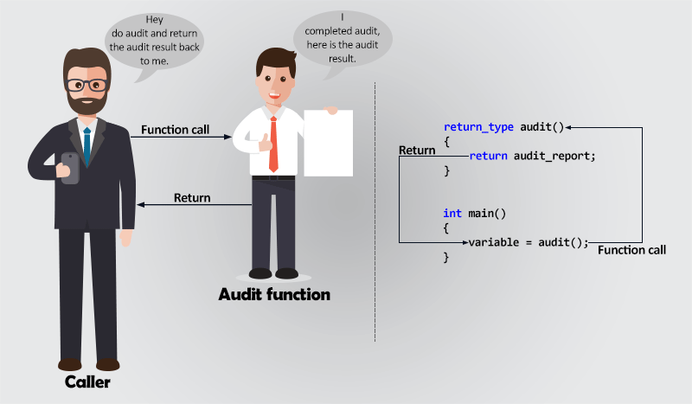
return Statement

Slide 23
Functions with no arguments and with return value
For this type of functions we have void in the parameter list but we set the return type to match the type of value returned by the function.
Function with return but no arguments, returns a value but does not accept any argument. This type of function communicates with the caller function by returning value back to the caller.
return_type function_name( )
{
// Function body
return some_value;
}
Syntax:
Run Example Code
See Example Code

Slide 24
Functions with Arguments and no return value
Function with no return but with arguments, does not return a value but accepts arguments as input. For this type of function you must define function return type as void.
Syntax:
void function_name(type arg1, type arg2, ...)
{
// Function body
}
See Example Code
Run Example Code

Slide 25
Functions with arguments and with return value
Function with return value and arguments, returns a value and may accept arguments. Since the function accepts input and returns a result to the caller, hence this type of functions are most used and best for modular programming.
Syntax:
return_type function_name(type arg1, type arg2, ...)
{
// Function body
return some_variable;
}
See Example Code
Run Example Code

Slide 26
Types of Functions
Which is the best function type for my program?
Choosing a correct function type completely depends on the programming need.
Consider function with return and arguments. If your function requires input from other functions and returns the processed result back to the caller function. The returned value might be input for other function.
For example - double sqrt(double x), double pow(double x, double y) etc.
Consider function with return but no argument. If your function does not require any input from other function. Rather, it just produce some output that may be input to other functions.
For example - int rand(void), int getchar(void) etc.

Slide 27
Types of Functions
Consider function with no return but arguments. If your function is dependent on the input of some other function. But, does not generates any output that could be consumed by the caller function.
For example - void free(void *ptr), void exit(int status) etc.
Consider function with no return and no argument. If your function works as an independent block. It does not communicate with other functions.
For example - void abort(void)

Slide 28
Standard Library Functions
The standard library functions are built-in functions in C programming to handle tasks such as mathematical computations, I/O processing, string handling etc. The functions allow reuse tested code fragments
These functions are defined in the header file. When you include the header file, these functions are available for use.
You need to prepend library name with #include
Example:
The printf() is a standard library function to send formatted output to the screen (display output on the screen). This function is defined in "stdio.h" header file.

Slide 29
Math Library Functions
Math library functions
perform common mathematical calculations
#include <math.h>
Format for calling functions
functionName( argument );
If multiple arguments, use comma-separated list
printf( "%.2f", sqrt( 900.0 ) );
Calls function sqrt, which returns the square root of its argument
All math functions return data type double
Arguments may be constants, variables, or expressions

Slide 30
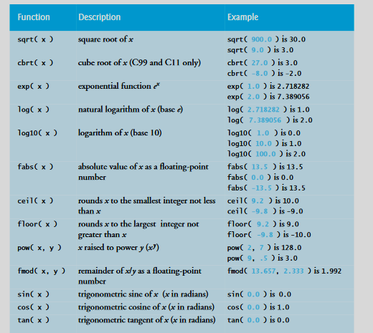
Common Library Functions
Below is the list of common library functions used to implement information hiding in structured programming.

Slide 31
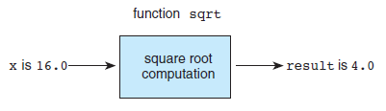
Function sqrt as a “Black Box”

Slide 32
Finding the Area and Circumference of a Circle
Case Study-1

Slide 33
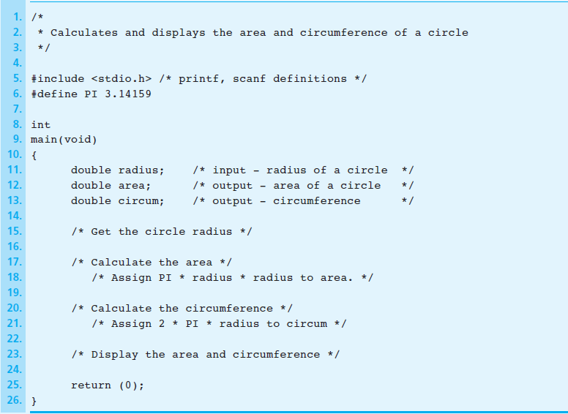
Outline of Program for area and
circumference Circle
See Code

Slide 34
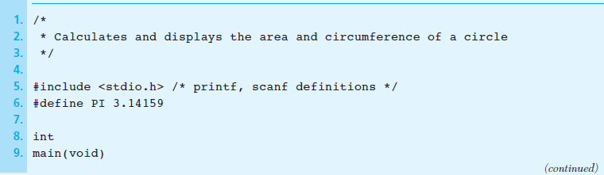
Calculating the Area and the Circumference of a Circle

Slide 35
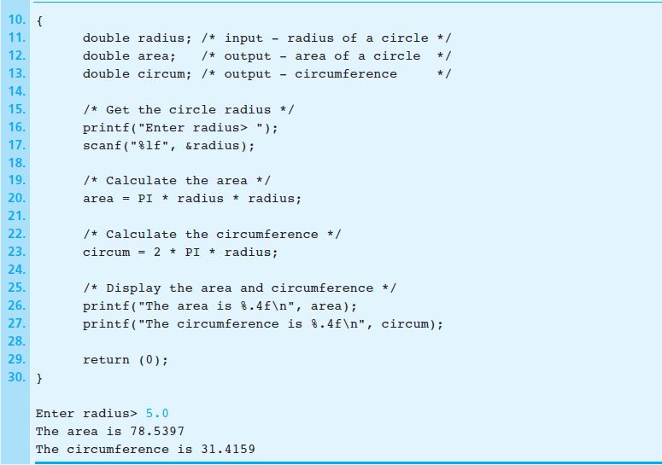
Calculating the Area and the Circumference
of a Circle

Slide 36
Computing the Weight of a Batch of Flat Washers
Case Study-2

Slide 37
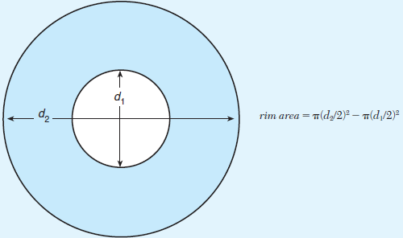
Computing the Rim Area of a Flat Washer

Slide 38
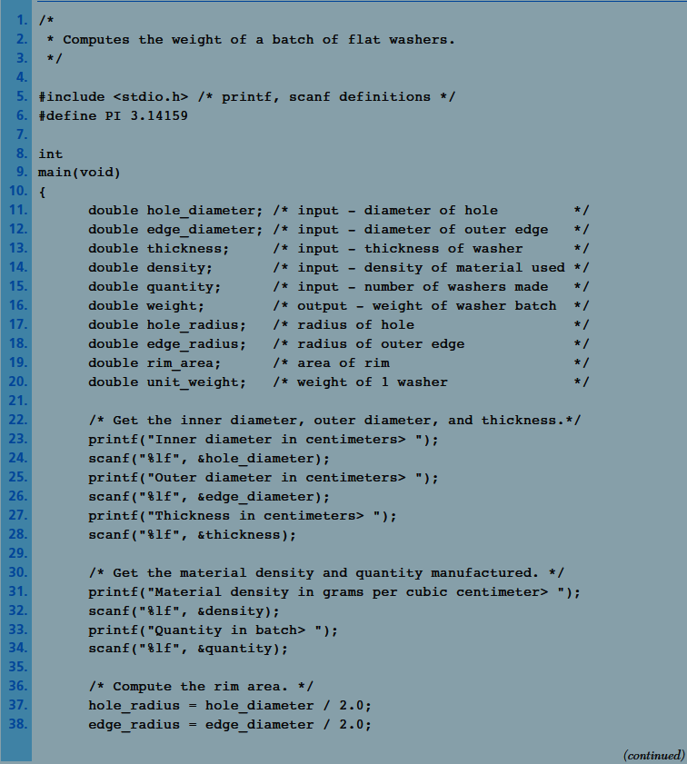
Flat Washer Program

Slide 39
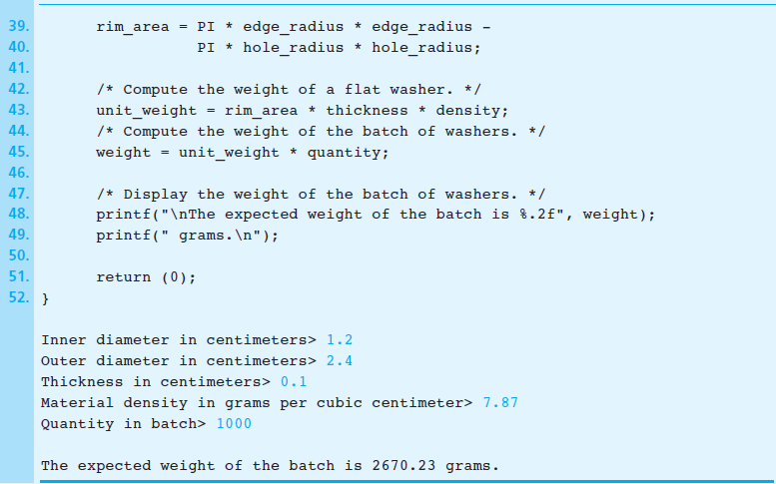
Flat Washer Program

Slide 40
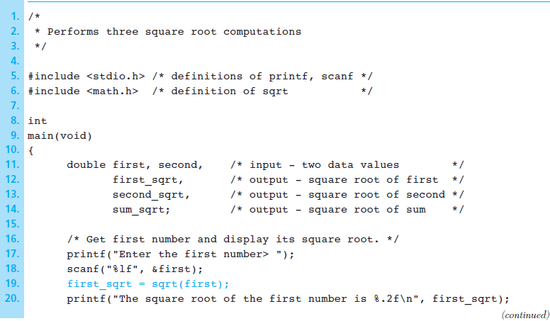
Square Root Program

Slide 41
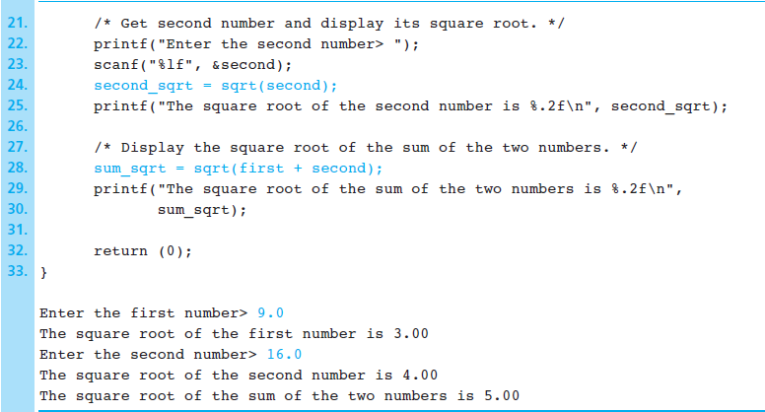
Square Root Program

Slide 42
Function Prototypes
A function prototype is simply the declaration of a function that specifies function's name, parameters and return type. It doesn't contain function body.
A function prototype gives information to the compiler that the function may later be used in the program.
Syntax:
returnType functionName(type1 argument1, type2 argument2,...);
Note: It is common programming practice to construct your function prototype before the actual function is built.

Slide 43
Function Prototypes
Example: float addTwoNumbers(int, int);
This function prototype tells C the following things about the function:
• The data type returned by the function—in this case a float data type is returned
• The number of parameters received—in this case two
• The data types of the parameters—in this case both parameters are integer data types
• The order of the parameters. Consider the following exaples
void printBalance(int); //function prototype, the function printBalance will not return a value but takes an integer parameter
int createRandomNumber(void); //function prototype. Function does not accept any parameters, but it will return an integer value.

Slide 44
Function Prototypes
Function prototypes should be placed before the main() function starts:
#include <stdio.h>
int addTwoNumbers(int, int); //function prototype
main()
{
-----
}
#include <stdio.h>
int addTwoNumbers(int, int); //function prototype
int subtractTwoNumbers(int, int); //function prototype
int divideTwoNumbers(int, int); //function prototype
int multiplyTwoNumbers(int, int); //function prototype
main()
{
---
}
You may have any number of prototypes

Slide 45
Function Prototypes
Functions definition implements the functions prototypes:
#include <stdio.h>
int addTwoNumbers(int, int); //function prototype
main()
{
printf("Nothing happening in here.");
}
//function definition
int addTwoNumbers(int operand1, int operand2)
{
return operand1 + operand2;
}
Note the differences between prototypes and definition?

Slide 46
An Example
An example to build two functions to perform basic math operations and return a result-addition and subtraction
See Example Code
Run Example Code

Slide 47
Function Prototypes
Purposes of a Function Prototype
A function prototype ensures that calls to a function are made with the correct number and types of arguments.
A function prototype specifies the number of arguments.
It states the data type of each of the passed arguments.
It gives the order in which the arguments are passed to the function.
Benefits of Function Prototypes
Prototypes save debugging time.
Prototypes prevent problems that occur when you compile using functions that were not declared.
When function overloading occurs, the prototypes distinguish which function version to call.

Slide 48
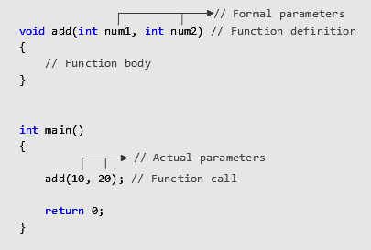
Function Calls
Function arguments are the inputs passed to a function.
A variable that accepts function argument is known as function parameter.
A function argument is referred to as actual parameter and function parameter is referred as formal parameter
Note: These terms may be used inter-changeably

Slide 49
Function Calls
Function argument-
Call by Value
Call by reference
Call by Value
Call by value is the default mechanism to pass arguments to a function. In Call by value, during function call actual parameter value is copied and passed to formal parameter. Changes made to the formal parameters does not affect the actual parameter.
See Code Example
Run Code Example

Slide 50
Function Calls
Call by reference
In call by reference we pass memory location (reference) of actual parameter to formal parameter. It uses pointers to pass reference of an actual parameter to formal parameter. Changes made to the formal parameter immediately reflects to actual parameter.
See Code Example
Run Code Example
In the example instead of passing a copy of n1 and n2, we are passing reference to the swap() function. Operations performed on formal parameter is reflected to actual parameter (original value). Hence, actual swapping is performed inside swap() as well as main() function.

Slide 51
Variable Scope
Variable scope identifies and determines the life span of any variable in any programming language. When a variable loses its scope, it means its data value is lost
Local Variable
Local variables are defined in functions, such as the main() function, and lose their scope each time the function is executed
#include <stdio.h>
main()
{
int num1;
printf("\nEnter a number: ");
scanf("%d", &num1);
printf("\nYou entered %d\n ", num1);
}
Example

Slide 52
Variable Scope
Note:
Because local scope variables are tied to their originating functions, you can reuse variable names in other functions without running the risk of overwriting data.
#include <stdio.h>
int getSecondNumber(); //function prototype
main()
{
int num1;
printf("\nEnter a number: ");
scanf("%d", &num1);
printf("\nYou entered %d and %d\n ", num1, getSecondNumber());
}
//function definition
int getSecondNumber ()
{
int num1;
printf("\nEnter a second number: ");
scanf("%d", &num1);
return num1;
}

Slide 53
Global Scope
Locally scoped variables can be reused in other functions without harming one another’s contents. At times, however, you might want to share data between and across functions. To support the concept of sharing data, you can create and use global variables.
Global variables are created and defined outside any function, including the main() function.

Slide 54
Global Scope
#include <stdio.h>
void printLuckyNumber(); //function prototype
int iLuckyNumber; //global variable
main()
{
printf("\nEnter your lucky number: ");
scanf("%d", &iLuckyNumber);
printLuckyNumber();
}
//function definition
void printLuckyNumber()
{
printf("\nYour lucky number is: %d\n", iLuckyNumber);
}

Slide 55
Lesson-3: Assignments and Group Project
1.Write a function prototype for the following components:
• A function that divides two numbers and returns the remainder
• A function that finds the larger of two numbers and returns the result
• A function that prints an ATM menu—it receives no parameters and returns no value
2. Build the function definitions for each preceding function prototype.

Slide 56
END OF LESSON3

Slide 57
#include <stdio.h>
/* Addition function declaration */
int add(int num1, int num2);
/* Main function definition */
int main()
{
/* Variable declaration */
int n1, n2, sum;
/* Input two numbers from user */
printf("Enter two numbers: ");
scanf("%d%d", &n1, &n2);
/*
* Addition function call.
* n1 and n2 are parameters passed to add function.
* Value returned by add() is stored in sum.
*/
sum = add(n1, n2);
/* Print value of sum */
printf("Sum = %d", sum);
return 0;
}
/**
* Addition function definition.
*
* Return type of the function is int.
* num1 - First parameter of the function of int type.
* num2 - Second parameter of the function of int type.
*/
int add(int num1, int num2)
{
int s = num1 + num2;
/* Return value of sum to the main function */
return s;
}

Slide 58
/*Program is to list square of numbers from 1 to 10*/
/*Function main begins program execution*/
int main(void){
int x; //counter
//loop 10 times and calculate and output square of x each time
for(x=1;x<=10;++x){
printf(“%d”, square(x));//function call
} //end for
puts(“ “);
} //end main
//square function definition return the square of its parameter
int square(int y); //y is a copy of the argument to the function
{
return y*y;
} //end function square

Slide 59
#include <stdio.h>
int getInteger();
int main()
{
int n, i, flag = 0;
// no argument is passed to the function
// the value returned from the function is assigned to n
n = getInteger();
for(i=2; i<=n/2; ++i)
{
if(n%i==0){
flag = 1;
break;
}
}
if (flag == 1)
printf("%d is not a prime number.", n);
else
printf("%d is a prime number.", n);
return 0;
}
// getInteger() function returns integer entered by the user
int getInteger()
{
int n;
printf("Enter a positive integer: ");
scanf("%d",&n);
return n;
}
Example-1

Slide 60
/**
* C program to print random prime numbers
*/
#include <stdio.h>
#include <stdlib.h> // Used for rand() function
/* Function declaration */
int randPrime();
int main()
{
int i;
printf("Random 5 prime numbers are: \n");
for(i=1; i<=5; i++)
{
printf("%d\n", randPrime());
}
return 0;
}
/* Function definition */
int randPrime()
{
int i, n, isPrime;
isPrime = 0;
while(!isPrime)
{
n = rand(); // Generates a random number
/* Prime checking logic */
isPrime = 1;
for(i=2; i<=n/2; i++)
{
if(n%i==0)
{
isPrime = 0;
break;
}
}
if(isPrime ==1)
{
return n;
}
}
}
Example: Returns a prime number on each call

Slide 61
/**
* C program to print random prime numbers
*/
#include <stdio.h>
#include <stdlib.h> // Used for rand() function
/* Function declaration */
int randPrime();
int main()
{
int i;
printf("Random 5 prime numbers are: \n");
for(i=1; i<=5; i++)
{
printf("%d\n", randPrime());
}
return 0;
}
/* Function definition */
int randPrime()
{
int i, n, isPrime;
isPrime = 0;
while(!isPrime)
{
n = rand(); // Generates a random number
/* Prime checking logic */
isPrime = 1;
for(i=2; i<=n/2; i++)
{
if(n%i==0)
{
isPrime = 0;
break;
}
}
if(isPrime ==1)
{
return n;
}
}
}
Example: Returns a prime number on each call

Slide 62
/**
* C program to print natural numbers using functions
*/
#include <stdio.h>
/* Function declaration */
void printNaturalNumbers(int start, int end);
int main()
{
int s, e;
printf("Enter lower range to print natural numbers: ");
scanf("%d", &s);
printf("Enter upper limit to print natural numbers: ");
scanf("%d", &e);
printNaturalNumbers(s, e);
return 0;
}
/* Function definition */
void printNaturalNumbers(int start, int end)
{
printf("Natural numbers from %d to %d are: \n", start, end);
while(start <= end)
{
printf("%d, ", start);
start++;
}
}
Example: Program Print all natural numbers between start to end.

Slide 63
/**
* C check even odd using function
*/
#include <stdio.h>
/* Function declaration */
int evenOdd(int num);
int main()
{
int num, isEven;
printf("Enter a number: ");
scanf("%d", &num);
/* Function call */
isEven = evenOdd(num);
if(isEven == 0)
printf("The given number is EVEN.");
else
printf("The given number is ODD.");
return 0;
}
/* Function definition */
int evenOdd(int num)
{
/* Return 0 if num is even */
if(num % 2 == 0)
return 0;
else
return 1;
}
Example: Program to input a number and check if it is even or odd. Define a function to accepts the number and return a value 0 or 1. Return 0 if argument is even, otherwise return 1.

Slide 64
/*Calculate and display the area and circumference of a circle*/
#include<stdio.h> /*prinf scanf definitions*/
#define PI 3.14159
int main(void){
double radius, area, circumf; /* input radius, output area and circumf*/
/*Get the circle radius*/
printf(“Enter radius:”);
scanf(“%1f”, &radius);
/*Calculate the area*/
area = PI* radius *radius;
/*calculate the *circumference
*/
circumf =2 *PI*radius
/*Display the area and the *circumference
*/
printf(“The area is %.4f\n”, area);
printf(“The circumference is %.4f\n”), cicumf);
return (0);
}

Slide 65
#include <stdio.h>
//Program to add and subtract two numbers
int addTwoNumbers(int, int); //function prototype
int subtractTwoNumbers(int, int); //functionprototype
main()
{
printf("Nothing happening in here.");
}
//function definition
int addTwoNumbers(int num1, int num2)
{
return num1 + num2;
}
//function definition
int subtractTwoNumbers(int num1, int num2)
{
return num1 - num2;
}

Slide 66
/**
* C program to swap two numbers using call by reference
*/
#include <stdio.h>
/**
* *num1 - pointer variable to accept memory address
* *num2 - pointer variable to accept memory address
*/
void swap(int * num1, int * num2)
{
int temp;
printf("In Function values before swapping: %d %d\n", *num1, *num2);
temp = *num1;
*num1 = *num2;
*num2 = temp;
printf("In Function values after swapping: %d %d\n\n", *num1, *num2);
}
/* main() function declaration */
int main()
{
int n1, n2;
printf("Enter two numbers: ");
scanf("%d%d", &n1, &n2);
printf("In Main values before swapping: %d %d\n\n", n1, n2);
/*
* &n1 - & evaluate memory address of n1
* &n2 - & evaluate memory address of n2
*/
swap(&n1, &n2);
printf("In Main values after swapping: %d %d", n1, n2);
return 0;
}
Call by Reference

Slide 67
/**
* C program to swap two numbers using call by value
*/
#include <stdio.h>
/* Swap function definition */
void swap(int num1, int num2)
{
int temp;
printf("In Function values before swapping: %d %d\n", num1, num2);
temp = num1;
num1 = num2;
num2 = temp;
printf("In Function values after swapping: %d %d\n\n", num1, num2);
}
/* main() function definition */
int main()
{
int n1, n2;
/* Input two integers from user */
printf("Enter two numbers: ");
scanf("%d%d", &n1, &n2);
/* Print value of n1 and n2 in before swapping */
printf("In Main values before swapping: %d %d\n\n", n1, n2);
/* Function call to swap n1 and n2 */
swap(n1, n2);
printf("In Main values after swapping: %d %d", n1, n2);
return 0;
}
Example: Function:to swap two numbers.

